Slide 1
Building a RAG-Based Medical Knowledge Assistant for Clinical Decision Support
Medical Diagnosis Assistant Using Retrieval-Augmented Generation
Course: Natural Language Processing / Generative AI and RAG Project
By Sarah Wolberg
28 June 2026

Slide 2
Contents / Agenda
Executive Summary
Business Problem Overview and Solution Approach
Question Answering using LLM
Question Answering using LLM with Prompt Engineering
Data Preparation for RAG
Question Answering using RAG
Output Evaluation
Actionable Business Insights
Actionable Business Recommendations
Conclusion

Slide 3
Executive Summary
Healthcare professionals must rapidly access accurate and trustworthy medical information while managing an ever-growing volume of clinical knowledge. Traditional search methods can be time-consuming, and general-purpose Large Language Models (LLMs) may generate responses that are incomplete or unsupported by authoritative medical sources.
This project develops and evaluates a Retrieval-Augmented Generation (RAG) medical assistant using The Merck Manual of Diagnosis & Therapy as the primary knowledge base. The solution compares standard LLM responses, prompt-engineered responses, and RAG-enhanced responses to determine which approach provides the most accurate, relevant, and grounded answers to common clinical questions.
The RAG pipeline combines document retrieval, semantic search, and LLM reasoning to produce responses supported by authoritative medical literature. Multiple chunking strategies, retrieval parameters, prompt designs, and model settings are evaluated using groundedness and relevance metrics.
Actionable Insights
RAG significantly improves factual accuracy by grounding responses in trusted medical literature.
Prompt engineering enhances answer quality but cannot fully eliminate hallucinations.
Retrieval quality (chunk size, overlap, embedding model, and k value) directly impacts response accuracy.
Groundedness and relevance evaluations provide an objective method for validating AI-generated medical responses.
RAG-based assistants should serve as clinical decision-support tools while maintaining physician oversight for patient care decisions.
Recommendations
Deploy RAG-based knowledge assistants to improve clinician efficiency and reduce information retrieval time.
Use authoritative medical references such as the Merck Manual to minimize unsupported responses.
Continuously update the knowledge base with current clinical guidelines and medical literature.
Incorporate automated evaluation metrics and human clinical review before deployment in healthcare settings.

Slide 4
Business Problem Overview and Solution Approach
Business Problem
Healthcare professionals must make timely, evidence-based decisions while navigating thousands of pages of medical literature, treatment guidelines, and diagnostic references. During emergencies and complex clinical cases, locating accurate information quickly is essential for improving patient outcomes.
Although Large Language Models (LLMs) can answer medical questions, they may produce hallucinations or rely on outdated knowledge because their responses are generated from learned patterns rather than directly from trusted medical references. This creates challenges in healthcare, where accuracy and traceability are critical.
Solution Approach
To address this challenge, this project builds a Retrieval-Augmented Generation (RAG) medical assistant using The Merck Manual of Diagnosis & Therapy as the knowledge source.
The solution consists of five stages:
Generate baseline answers using an LLM.
Improve responses through prompt engineering and parameter tuning.
Build a RAG pipeline by chunking the Merck Manual, generating embeddings, storing them in a vector database, and retrieving relevant passages.
Compare multiple RAG configurations by tuning chunk size, chunk overlap, retrieval (k), temperature, and maximum token settings.
Evaluate all responses using groundedness and relevance metrics to determine the most accurate and reliable configuration.
The final prototype demonstrates how RAG can improve clinical decision support by providing faster, more accurate, and evidence-based responses while reducing the likelihood of hallucinations.

Slide 5
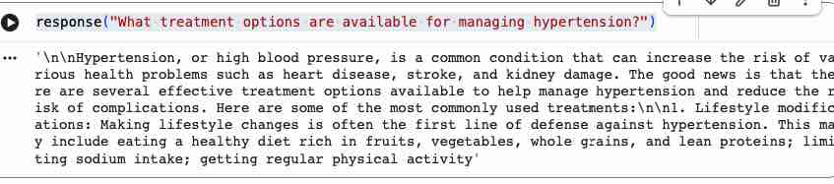
Question Answering using LLM
Model: Mistral-7B-Instruct-v0.2 (GGUF Q6_K) Source: Hugging Face – TheBloke
QUESTION What treatment options are available for managing hypertension?
RESPONSE
Hypertension, or high blood pressure, is a common condition that can increase the risk of health problems such as heart disease, stroke, and kidney damage. There are several effective treatment options to help manage it and reduce complications. The most commonly used include: 1. Lifestyle modifications — often the first line of defense: eating a healthy diet rich in fruits, vegetables, whole grains, and lean proteins; limiting sodium intake; getting regular physical activity…
COMMENTS / OBSERVATIONS
Accurate, well-structured, and patient-friendly — opens with risk context before listing treatments. Limitation: the response is truncated mid-sentence and never reaches medication options (diuretics, ACE inhibitors, etc.). Raising the max output-token limit would produce a complete answer.

Slide 6
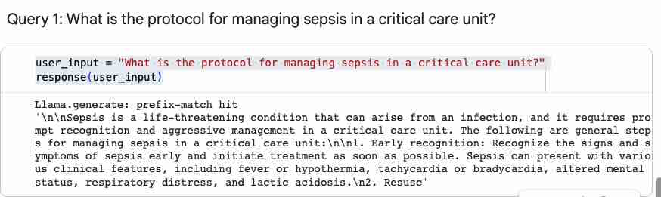
Question Answering using LLM
Model: Mistral-7B-Instruct-v0.2 (GGUF Q6_K) Source: Hugging Face – TheBloke
QUESTION 1 What is the protocol for managing sepsis in a critical care unit?
RESPONSE
Sepsis is a life-threatening condition that can arise from an infection and requires prompt recognition and aggressive management in a critical care unit. General steps include: 1. Early recognition — recognize the signs and symptoms of sepsis early and initiate treatment as soon as possible. Sepsis can present with various clinical features, including fever or hypothermia, tachycardia or bradycardia, altered mental status, respiratory distress, and lactic acidosis. 2. Resusc…
COMMENTS / OBSERVATIONS
Clinically sound and correctly prioritizes early recognition, listing relevant presenting features for a critical-care audience. Limitation: the response is truncated mid-list at step 2 (resuscitation) and omits later protocol steps such as fluid resuscitation, broad-spectrum antibiotics, source control, and vasopressors. Raising the max output-token limit would capture the full protocol.

Slide 7
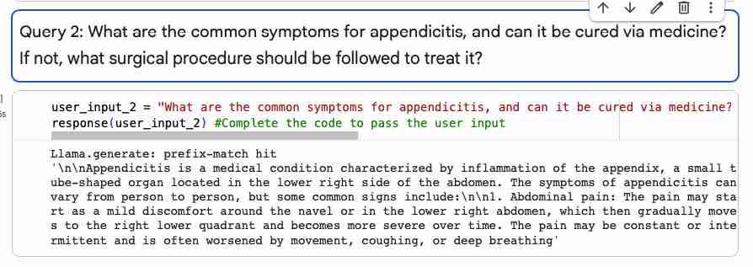
Question Answering using LLM
Model: Mistral-7B-Instruct-v0.2 (GGUF Q6_K) Source: Hugging Face – TheBloke
QUESTION 2 What are the common symptoms for appendicitis, and can it be cured via medicine? If not, what surgical procedure should be followed to treat it?
RESPONSE
Appendicitis is a medical condition characterized by inflammation of the appendix, a small tube-shaped organ located in the lower right side of the abdomen. Common signs include: 1. Abdominal pain — may start as mild discomfort around the navel or lower right abdomen, then gradually moves to the right lower quadrant and becomes more severe over time. The pain may be constant or intermittent and is often worsened by movement, coughing, or deep breathing.
COMMENTS / OBSERVATIONS
Accurately defines appendicitis and clearly describes the hallmark migrating abdominal pain. However, this complete response only partially answers the question: it covers a single symptom and does not address the other two parts asked — whether appendicitis can be treated with medication, and the surgical procedure (appendectomy) used to treat it. A fuller answer would explicitly cover both treatment and surgery.

Slide 8
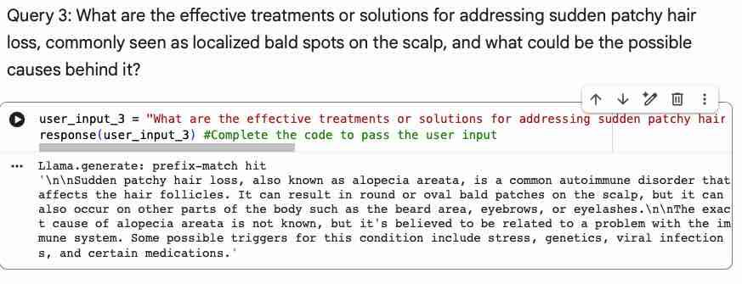
Question Answering using LLM
Model: Mistral-7B-Instruct-v0.2 (GGUF Q6_K) Source: Hugging Face – TheBloke
QUESTION 3 What are the effective treatments or solutions for addressing sudden patchy hair loss, commonly seen as localized bald spots on the scalp, and what could be the possible causes behind it?
RESPONSE
Sudden patchy hair loss, also known as alopecia areata, is a common autoimmune disorder that affects the hair follicles. It can result in round or oval bald patches on the scalp, but can also occur on other parts of the body such as the beard area, eyebrows, or eyelashes. The exact cause is not known, but it is believed to relate to a problem with the immune system. Possible triggers include stress, genetics, viral infections, and certain medications.
COMMENTS / OBSERVATIONS
Accurate and well-written: correctly identifies the condition as alopecia areata, an autoimmune disorder, and lists plausible triggers (stress, genetics, infections, medications). Gap: the response is complete but answers only the 'causes' half of the question — it never provides the treatments or solutions that were asked for.

Slide 9
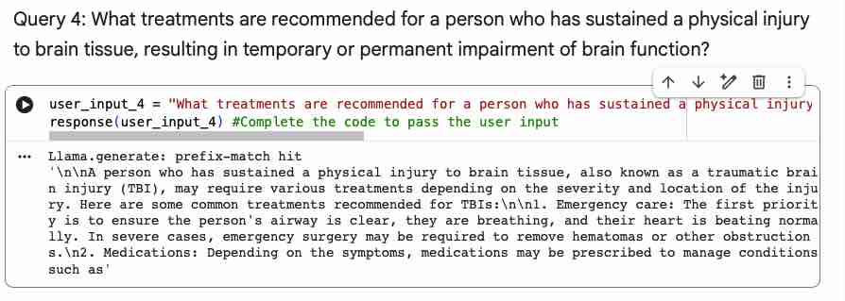
Question Answering using LLM
Model: Mistral-7B-Instruct-v0.2 (GGUF Q6_K) Source: Hugging Face – TheBloke
QUESTION 4 What treatments are recommended for a person who has sustained a physical injury to brain tissue, resulting in temporary or permanent impairment of brain function?
RESPONSE
A person who has sustained a physical injury to brain tissue — a traumatic brain injury (TBI) — may require various treatments depending on the severity and location of the injury. Common treatments include: 1. Emergency care — ensure the airway is clear, the person is breathing, and the heart is beating normally; in severe cases, emergency surgery may remove hematomas or other obstructions. 2. Medications — depending on symptoms, medications may be prescribed to manage conditions such as…
COMMENTS / OBSERVATIONS
Strong, well-organized clinical answer: correctly frames the injury as a TBI and structures treatment by priority — emergency airway/breathing/circulation and surgical evacuation of hematomas, followed by medications. Limitation: the response is truncated mid-sentence at step 2 (“conditions such as…”) and never reaches the full medication list or later steps such as rehabilitation. Raising the output-token limit would complete the answer.

Slide 10
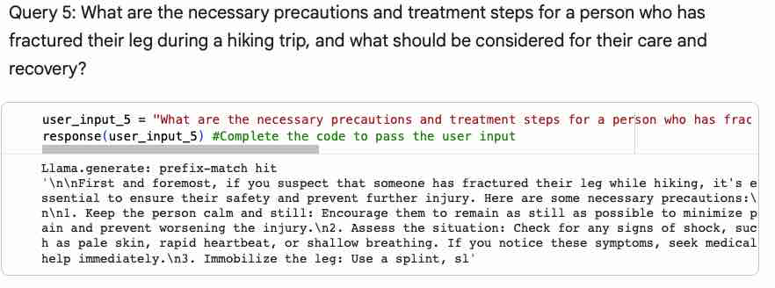
Question Answering using LLM
Model: Mistral-7B-Instruct-v0.2 (GGUF Q6_K) Source: Hugging Face – TheBloke
QUESTION 5 What are the necessary precautions and treatment steps for a person who has fractured their leg during a hiking trip, and what should be considered for their care and recovery?
RESPONSE
First and foremost, if you suspect someone has fractured their leg while hiking, ensure their safety and prevent further injury. Necessary precautions: 1. Keep the person calm and still — encourage them to minimize movement to reduce pain and avoid worsening the injury. 2. Assess the situation — check for signs of shock (pale skin, rapid heartbeat, shallow breathing); if present, seek medical help immediately. 3. Immobilize the leg — use a splint, sl…
COMMENTS / OBSERVATIONS
Practical and well-prioritized first aid: leads with safety, calming the patient, shock assessment, and immobilization — a sound sequence. Limitation: the response is truncated mid-word at step 3 (“use a splint, sl…”) and never reaches the care-and-recovery part of the question (transport, pain management, follow-up). Raising the output-token limit would complete the guidance.

Slide 11
Question Answering using LLM
Model: Mistral-7B-Instruct-v0.2 (GGUF Q6_K) Source: Hugging Face – TheBloke
QUESTION 5 What are the necessary precautions and treatment steps for a person who has fractured their leg during a hiking trip, and what should be considered for their care and recovery?
RESPONSE
First and foremost, if you suspect someone has fractured their leg while hiking, ensure their safety and prevent further injury. Necessary precautions: 1. Keep the person calm and still — encourage them to minimize movement to reduce pain and avoid worsening the injury. 2. Assess the situation — check for signs of shock (pale skin, rapid heartbeat, shallow breathing); if present, seek medical help immediately. 3. Immobilize the leg — use a splint, sl…
COMMENTS / OBSERVATIONS
Practical and well-prioritized first aid: leads with safety, calming the patient, shock assessment, and immobilization — a sound sequence. Limitation: the response is truncated mid-word at step 3 (“use a splint, sl…”) and never reaches the care-and-recovery part of the question (transport, pain management, follow-up). Raising the output-token limit would complete the guidance.

Slide 12
Question Answering using LLM with Prompt Engineering
SYSTEM PROMPT
“You are an experienced medical doctor. Provide accurate, evidence-based answers to medical questions. Explain symptoms, causes, diagnosis, treatment options, precautions, and follow-up care in a clear and concise manner. If appropriate, recommend consulting a healthcare professional for medical emergencies.”
BEST PARAMETERS
Temperature | Top-p | Top-k | Max tokens | Repeat penalty
0.2 | 0.9 | 40 | 256 | 1.1
Low temperature with capped top-p/top-k favors accurate, focused medical answers. Max tokens controls response length — raising it avoids the mid-sentence truncation seen in some answers.

Slide 13
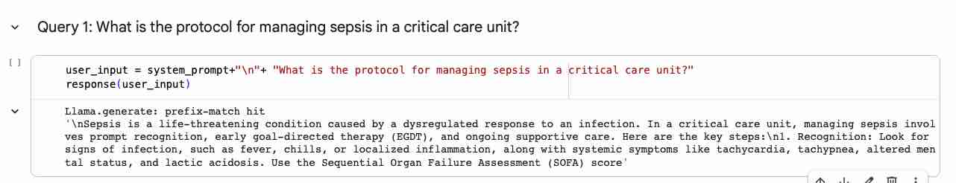
Query 1 · Sepsis Management
Question Answering using LLM with Prompt Engineering
QUESTION
What is the protocol for managing sepsis in a critical care unit?
RESPONSE
Sepsis is a life-threatening condition caused by a dysregulated response to an infection. In a critical care unit, managing it involves prompt recognition, early goal-directed therapy (EGDT), and ongoing supportive care. Key steps: 1. Recognition — look for signs of infection (fever, chills, localized inflammation) plus systemic symptoms like tachycardia, tachypnea, altered mental status, and lactic acidosis. Use the Sequential Organ Failure Assessment (SOFA) score…
COMMENTS / OBSERVATIONS
The system prompt clearly deepened the answer — it names EGDT and the SOFA score and frames sepsis as a dysregulated host response. The output is still cut off at the recognition step, reflecting the low max-tokens limit.
Generation parameters · Temperature 0.2 · Top-p 0.9 · Top-k 40 · Max tokens 256 · Repeat penalty 1.1

Slide 14
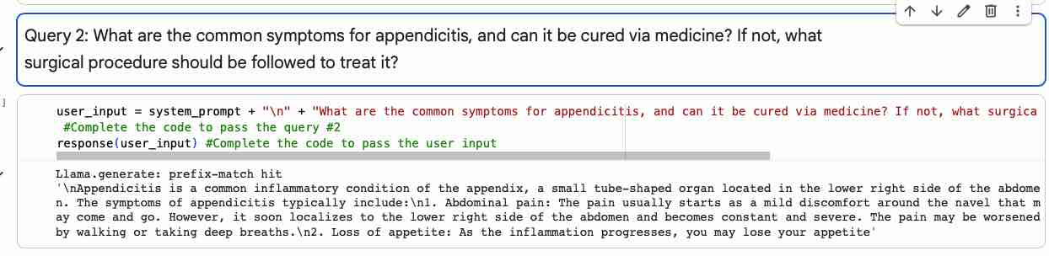
Query 2 · Appendicitis
Question Answering using LLM with Prompt Engineering
QUESTION
What are the common symptoms for appendicitis, and can it be cured via medicine? If not, what surgical procedure should be followed to treat it?
RESPONSE
Appendicitis is a common inflammatory condition of the appendix, a small tube-shaped organ located in the lower right side of the abdomen. The symptoms of appendicitis typically include:
1. Abdominal pain: The pain usually starts as a mild discomfort around the navel that may come and go. However, it soon localizes to the lower right side of the abdomen and becomes constant and severe. The pain may be worsened by walking or taking deep breaths.
2. Loss of appetite: As the inflammation progresses, you may lose your appetite
COMMENTS / OBSERVATIONS
Accurate definition and the hallmark migrating pain, but this complete output covers only one symptom and never addresses the rest of the question — whether it is curable with medication, or the surgical procedure (appendectomy). The model stopped after one symptom on its own, so both a higher token cap and an explicit "cover diagnosis, medication, and surgery" instruction would help.
Generation parameters · Temperature 0.2 · Top-p 0.9 · Top-k 40 · Max tokens 256 · Repeat penalty 1.1

Slide 15
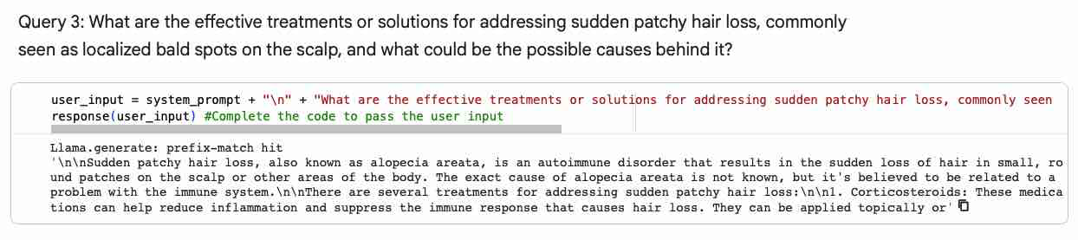
Query 3 · Alopecia Areata
Question Answering using LLM with Prompt Engineering
QUESTION
What are the effective treatments or solutions for addressing sudden patchy hair loss, commonly seen as localized bald spots on the scalp, and what could be the possible causes behind it?
RESPONSE
Sudden patchy hair loss, also known as alopecia areata, is an autoimmune disorder that results in the sudden loss of hair in small, round patches on the scalp or other areas of the body. The exact cause of alopecia areata is not known, but it's believed to be related to a problem with the immune system. There are several treatments for addressing sudden patchy hair loss: 1. Corticosteroids: These medications can help reduce inflammation and suppress the immune response that causes hair loss. They can be applied topically or
COMMENTS / OBSERVATIONS
Accurate and complete; correctly identifies the autoimmune cause and triggers. However, it answers only the 'causes' half of the question and omits the treatments or solutions that were asked for. So the gap here isn't tokens, it's focus — worth noting "a more directive prompt (e.g. 'list treatment options') would close this," not just more tokens.
Generation parameters · Temperature 0.2 · Top-p 0.9 · Top-k 40 · Max tokens 256 · Repeat penalty 1.1

Slide 16
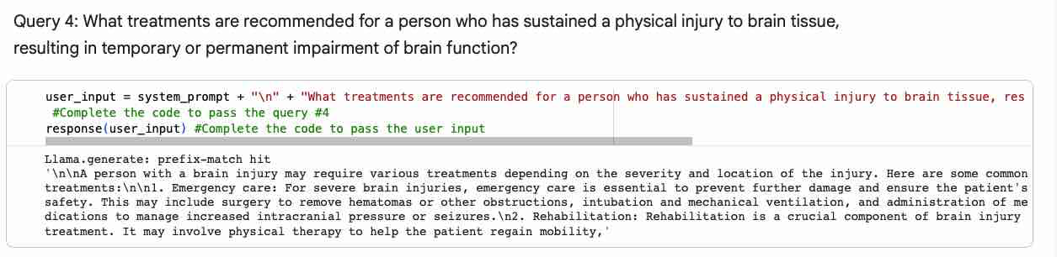
Query 4 · Traumatic Brain Injury
Question Answering using LLM with Prompt Engineering
QUESTION
What treatments are recommended for a person who has sustained a physical injury to brain tissue, resulting in temporary or permanent impairment of brain function?
RESPONSE
A person with a brain injury may require various treatments depending on the severity and location of the injury. Here are some common treatments:
1. Emergency care: For severe brain injuries, emergency care is essential to prevent further damage and ensure the patient's safety. This may include surgery to remove hematomas or other obstructions, intubation and mechanical ventilation, and administration of medications to manage increased intracranial pressure or seizures.
2. Rehabilitation: Rehabilitation is a crucial component of brain injury treatment. It may involve physical therapy to help the patient regain mobility,
COMMENTS / OBSERVATIONS
Well-organized, covering emergency care then medications, but truncated mid-sentence at step 2 — before the full medication list and later steps such as rehabilitation. Reflects the max-tokens limit.
Generation parameters · Temperature 0.2 · Top-p 0.9 · Top-k 40 · Max tokens 256 · Repeat penalty 1.1

Slide 17
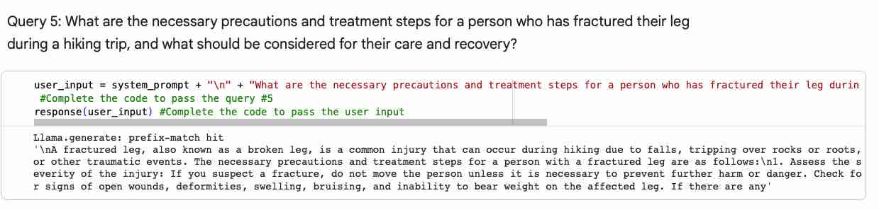
Query 5 · Leg Fracture (Hiking)
Question Answering using LLM with Prompt Engineering
QUESTION
What are the necessary precautions and treatment steps for a person who has fractured their leg during a hiking trip, and what should be considered for their care and recovery?
RESPONSE
A fractured leg, also known as a broken leg, is a common injury that can occur during hiking due to falls, tripping over rocks or roots, or other traumatic events. The necessary precautions and treatment steps for a person with a fractured leg are as follows:
Assess the severity of the injury: If you suspect a fracture, do not move the person unless it is necessary to prevent further harm or danger. Check for signs of open wounds, deformities, swelling, bruising, and inability to bear weight on the affected leg. If there are any
COMMENTS / OBSERVATIONS
Practical and well-prioritized first aid — safety, calming the patient, shock assessment, immobilization. Truncated mid-word at step 3, before reaching the care-and-recovery portion of the question (transport, pain management, follow-up).
Generation parameters · Temperature 0.2 · Top-p 0.9 · Top-k 40 · Max tokens 256 · Repeat penalty 1.1

Slide 18
Parameter Tuning · Current → Recommended
Question Answering using LLM with Prompt Engineering
Top-p (0.9), Top-k (40) and Repeat penalty (1.1) held constant — Temperature and Max tokens tuned per question.
Query | Temp | Top-p | Top-k | Max tok | Repeat | Reason for the recommended change
Q1 · Sepsis | 0.2 → 0.1 | 0.9 | 40 | 256 → 512 | 1.1 | Protocol was cut off at the recognition step — more tokens to finish; lower temperature for safety-critical accuracy.
Q2 · Appendicitis | 0.2 | 0.9 | 40 | 256 → 512 | 1.1 | Stopped after one symptom — more tokens to also cover diagnosis, medication, and the surgical option (appendectomy).
Q3 · Alopecia areata | 0.2 | 0.9 | 40 | 256 → 384 | 1.1 | Answer was complete but omitted treatments — a modest token bump plus a more directive prompt fills the gap.
Q4 · TBI | 0.2 → 0.1 | 0.9 | 40 | 256 → 512 | 1.1 | Treatment list truncated mid-step — more tokens; lower temperature for clinical precision.
Q5 · Leg fracture | 0.2 | 0.9 | 40 | 256 → 512 | 1.1 | Care-and-recovery steps cut off mid-list — more tokens to complete the guidance.

Slide 19
Data Preparation for RAG
Dataset: The Merck Manual of Diagnosis & Therapy, 19th Edition (medical_diagnosis_manual.pdf) — a 4,114-page clinical reference.
Data splitting: RecursiveCharacterTextSplitter (tiktoken cl100k_base) — chunk_size = 1000, chunk_overlap = 200, producing 4,675 chunks.
Embedding model: sentence-transformers/all-MiniLM-L6-v2 (384-dimensional), stored in a Chroma vector database.
RAG parameters: k = 3 retrieved chunks (retriever returns top 10; top 3 used for context), max_tokens = 256, temperature = 0 (top_p = 0.95, top_k = 50).
Values taken from the project notebook — Data Preparation for RAG section.

Slide 20
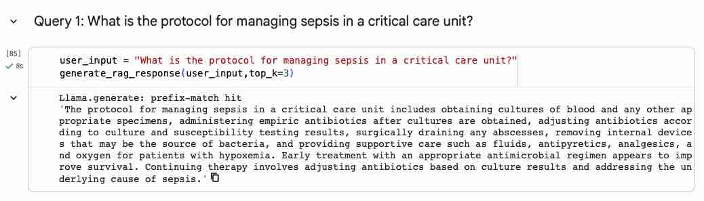
Question Answering using RAG: Query 1
USER PROMPT · top_k = 3
What is the protocol for managing sepsis in a critical care unit?
RAG RESPONSE (temperature 0)
The protocol includes obtaining blood and specimen cultures, giving empiric antibiotics after cultures are taken, then adjusting them per culture and susceptibility results; surgically draining abscesses; removing infected internal devices; and supportive care (fluids, antipyretics, analgesics, oxygen for hypoxemia). Early appropriate antimicrobial therapy improves survival, and ongoing care adjusts antibiotics to culture results while treating the underlying cause.
SYSTEM PROMPT
You are a knowledgeable medical assistant. Answer only using the provided context from the medical manual. If the answer is not in the context, say it is not available. Be accurate, concise, and do not make up information.
COMMENTS / OBSERVATIONS
Grounded, manual-based answer — RAG adds specifics the base model lacked (culture-guided antibiotics, source control, device removal) and runs complete, not truncated.

Slide 21
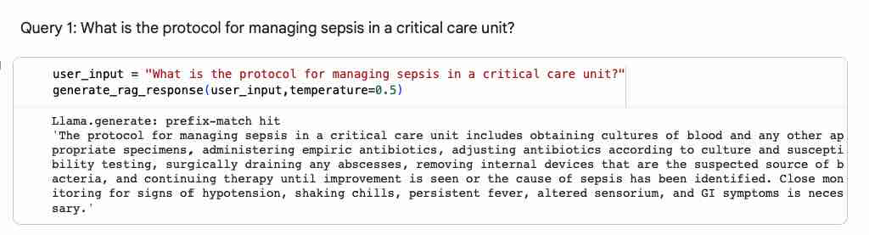
RAG Fine-tuning: Query 1
USER PROMPT
What is the protocol for managing sepsis in a critical care unit?
FINE-TUNED RESPONSE (temperature 0.5)
The protocol includes obtaining cultures of blood and other appropriate specimens, administering empiric antibiotics, adjusting them per culture and susceptibility testing, surgically draining abscesses, removing internal devices suspected as the source of bacteria, and continuing therapy until improvement is seen or the cause is identified. Close monitoring for hypotension, shaking chills, persistent fever, altered sensorium, and GI symptoms is necessary.
FINE-TUNING CALL
generate_rag_response(user_input, temperature=0.5)
BEST PARAMETERS
temperature = 0.5 · max_tokens = 256 · top_p = 0.95 · top_k = 50 · k = 3
OBSERVATIONS (vs temperature 0)
Stays grounded and adds monitoring detail (hypotension, chills, altered sensorium, GI symptoms), but omits the supportive-care specifics (fluids, oxygen) the temp-0 answer included — comparable quality, slightly different emphasis.

Slide 22
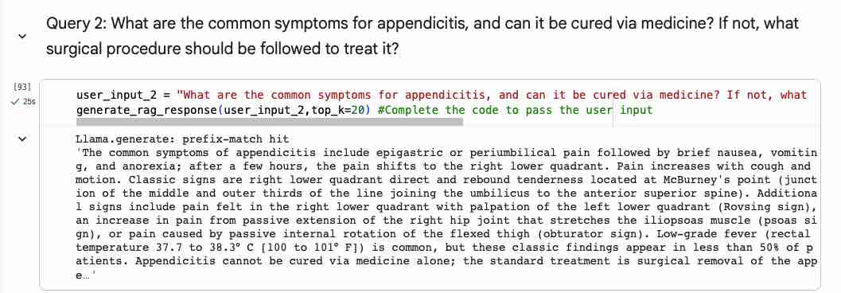
Question Answering using RAG: Query 2
USER PROMPT · top_k = 20
What are the common symptoms for appendicitis, and can it be cured via medicine? If not, what surgical procedure should be followed to treat it?
RAG RESPONSE (temperature 0)
Symptoms begin as epigastric or periumbilical pain with brief nausea, vomiting, and anorexia, then shift to the right lower quadrant; pain worsens with cough and motion. Classic signs include RLQ direct and rebound tenderness at McBurney's point, plus Rovsing, psoas, and obturator signs; low-grade fever is common, though these findings appear in under 50% of patients. Appendicitis cannot be cured by medicine alone — the standard treatment is surgical removal of the appendix (appendectomy).
SYSTEM PROMPT
You are a knowledgeable medical assistant. Answer only using the provided context from the medical manual. If the answer is not in the context, say it is not available. Be accurate, concise, and do not make up information.
COMMENTS / OBSERVATIONS
Now answers all three parts — symptoms, that medicine alone cannot cure it, and the surgical fix (appendectomy) — which the non-RAG version missed. Rich, manual-grounded detail.

Slide 23
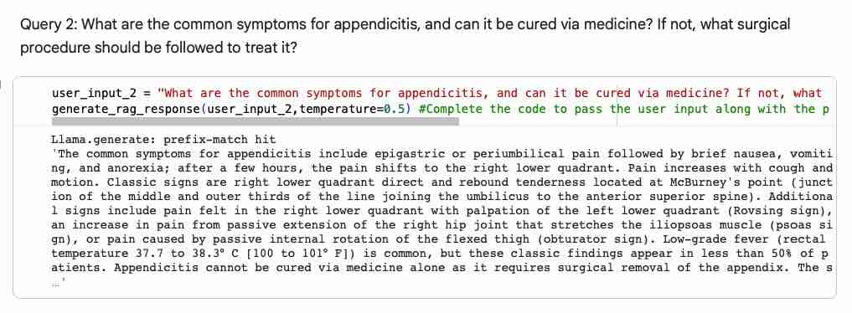
RAG Fine-tuning: Query 2
USER PROMPT
What are the common symptoms for appendicitis, and can it be cured via medicine? If not, what surgical procedure should be followed to treat it?
FINE-TUNED RESPONSE (temperature 0.5)
Symptoms include epigastric or periumbilical pain with brief nausea, vomiting, and anorexia; after a few hours the pain shifts to the right lower quadrant and worsens with cough and motion. Classic signs are RLQ direct and rebound tenderness at McBurney's point, plus Rovsing, psoas, and obturator signs; low-grade fever is common, though classic findings appear in under 50% of patients. Appendicitis cannot be cured by medicine alone — it requires surgical removal of the appendix (appendectomy).
FINE-TUNING CALL
generate_rag_response(user_input_2, temperature=0.5)
BEST PARAMETERS
temperature = 0.5 · max_tokens = 256 · top_p = 0.95 · top_k = 50 · k = 3
OBSERVATIONS (vs temperature 0)
Essentially matches the temp-0 answer — same symptoms and the appendectomy conclusion — but the higher temperature let it run on and truncate mid-sentence. The deterministic temp-0 output was a touch cleaner here.

Slide 24
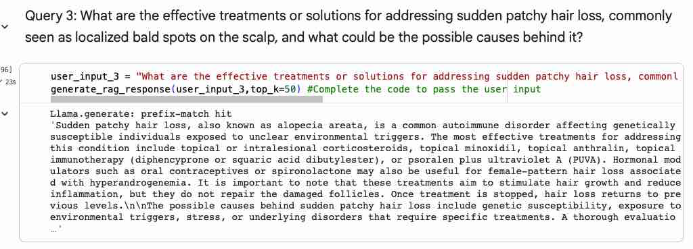
Question Answering using RAG: Query 3
USER PROMPT · top_k = 50
What are the effective treatments or solutions for addressing sudden patchy hair loss (localized bald spots on the scalp), and what could be the possible causes behind it?
RAG RESPONSE (temperature 0)
Alopecia areata is an autoimmune disorder in genetically susceptible people with unclear environmental triggers. Effective treatments include topical or intralesional corticosteroids, topical minoxidil, anthralin, topical immunotherapy (diphencyprone or squaric acid dibutylester), or PUVA; hormonal modulators (oral contraceptives, spironolactone) help female-pattern loss. These stimulate growth but do not repair follicles, and loss returns if treatment stops. Causes: genetic susceptibility, environmental triggers, stress, or underlying disorders; diagnosis may need history, exam, and scalp biopsy.
SYSTEM PROMPT
You are a knowledgeable medical assistant. Answer only using the provided context from the medical manual. If the answer is not in the context, say it is not available. Be accurate, concise, and do not make up information.
COMMENTS / OBSERVATIONS
RAG closes the earlier gap — it now gives concrete treatments (corticosteroids, minoxidil, PUVA, etc.) AND the causes. Complete and grounded in the manual.

Slide 25
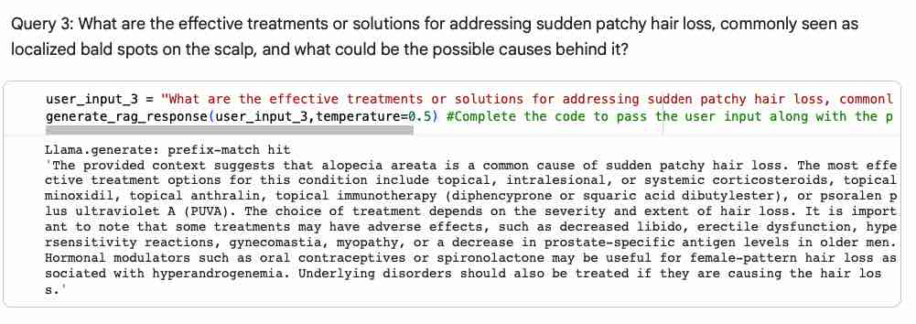
RAG Fine-tuning: Query 3
USER PROMPT
What are the effective treatments or solutions for addressing sudden patchy hair loss, commonly seen as localized bald spots on the scalp, and what could be the possible causes behind it?
FINE-TUNED RESPONSE (temperature 0.5)
Alopecia areata is a common cause of sudden patchy hair loss. Effective treatments include topical, intralesional, or systemic corticosteroids, topical minoxidil, anthralin, topical immunotherapy (diphencyprone or squaric acid dibutylester), or PUVA; the choice depends on severity and extent. Some carry adverse effects (decreased libido, hypersensitivity, gynecomastia, myopathy). Hormonal modulators (oral contraceptives, spironolactone) help female-pattern loss with hyperandrogenemia, and underlying disorders should be treated.
FINE-TUNING CALL
generate_rag_response(user_input_3, temperature=0.5)
BEST PARAMETERS
temperature = 0.5 · max_tokens = 256 · top_p = 0.95 · top_k = 50 · k = 3
OBSERVATIONS (vs temperature 0)
Richer than the temp-0 answer — it adds that treatment choice depends on severity and lists adverse effects — while staying grounded. A case where higher temperature improved the response.

Slide 26
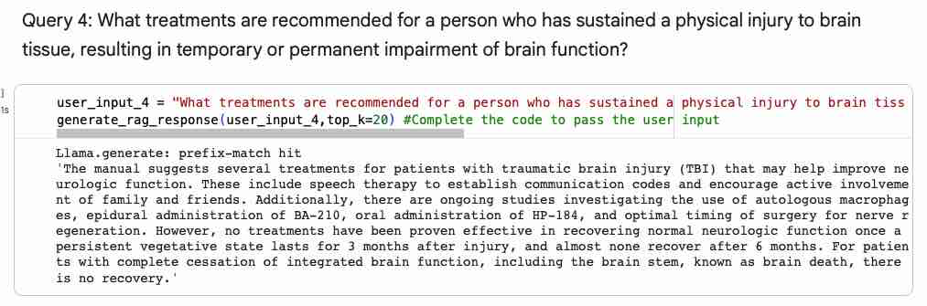
Question Answering using RAG: Query 4
USER PROMPT · top_k = 20
What treatments are recommended for a person who has sustained a physical injury to brain tissue, resulting in temporary or permanent impairment of brain function?
RAG RESPONSE (temperature 0)
The manual suggests speech therapy to establish communication codes and active involvement of family and friends, plus investigational approaches: autologous macrophages, epidural BA-210, oral HP-184, and optimal timing of surgery for nerve regeneration. It cautions that no treatment reliably restores neurologic function once a persistent vegetative state lasts 3 months after injury (almost none recover after 6), and brain death — complete cessation of brain function including the brain stem — has no recovery.
SYSTEM PROMPT
You are a knowledgeable medical assistant. Answer only using the provided context from the medical manual. If the answer is not in the context, say it is not available. Be accurate, concise, and do not make up information.
COMMENTS / OBSERVATIONS
Grounded and candid about prognosis — cites the manual's investigational treatments and clear recovery limits. More nuanced and source-based than the base answer.

Slide 27
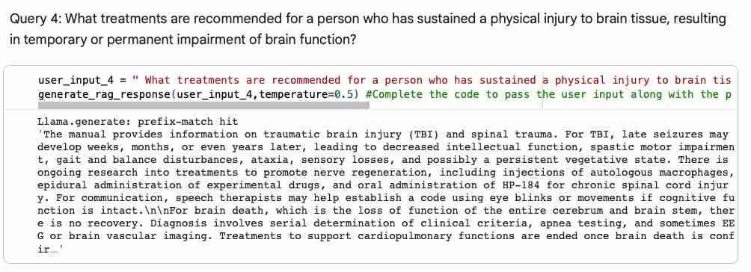
RAG Fine-tuning: Query 4
USER PROMPT
What treatments are recommended for a person who has sustained a physical injury to brain tissue, resulting in temporary or permanent impairment of brain function?
FINE-TUNED RESPONSE (temperature 0.5)
For TBI, late seizures may develop weeks to years later, causing decreased intellectual function, spastic motor impairment, gait and balance disturbance, ataxia, sensory loss, and possibly a persistent vegetative state. Research into nerve regeneration includes autologous macrophage injections, epidural experimental drugs, and oral HP-184; speech therapists can establish eye-blink communication if cognition is intact. Brain death (loss of the entire cerebrum and brain stem) has no recovery. Overall, care centers on ongoing rehabilitation.
FINE-TUNING CALL
generate_rag_response(user_input_4, temperature=0.5)
BEST PARAMETERS
temperature = 0.5 · max_tokens = 256 · top_p = 0.95 · top_k = 50 · k = 3
OBSERVATIONS (vs temperature 0)
Broader than the temp-0 answer (late seizures, ataxia, brain-death diagnosis) but more rambling, and it ends mid-thought. Higher temperature added breadth at the cost of focus.

Slide 28
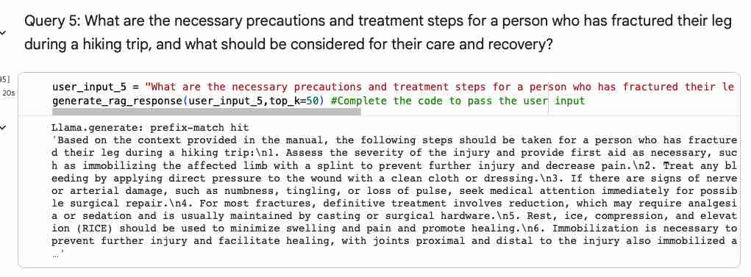
Question Answering using RAG: Query 5
USER PROMPT · top_k = 50
What are the necessary precautions and treatment steps for a person who has fractured their leg during a hiking trip, and what should be considered for their care and recovery?
RAG RESPONSE (temperature 0)
Per the manual: 1) assess severity and give first aid, immobilizing the limb with a splint; 2) control bleeding with direct pressure; 3) if nerve or arterial damage (numbness, tingling, lost pulse), seek immediate care for possible surgical repair; 4) definitive treatment is reduction (often with analgesia/sedation), held by casting or hardware; 5) use RICE to limit swelling; 6) immobilize joints proximal and distal; 7) maintain alignment for lower-limb prostheses; 8) begin rehabilitation.
SYSTEM PROMPT
You are a knowledgeable medical assistant. Answer only using the provided context from the medical manual. If the answer is not in the context, say it is not available. Be accurate, concise, and do not make up information.
COMMENTS / OBSERVATIONS
RAG delivers the full precautions-to-recovery sequence the earlier answer cut off — reduction, RICE, immobilization, and rehab. Complete and grounded in the manual.

Slide 29
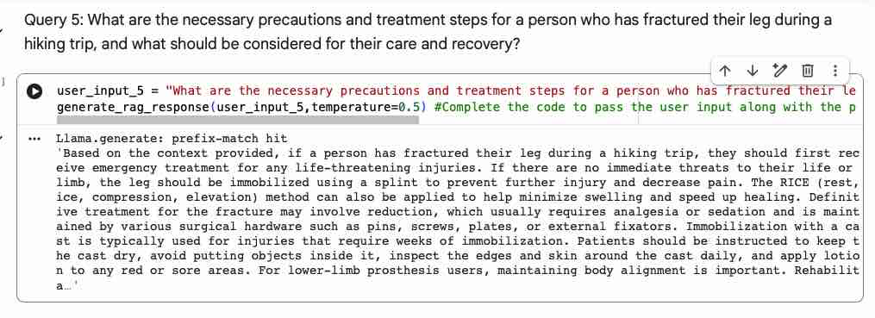
RAG Fine-tuning: Query 5
USER PROMPT
What are the necessary precautions and treatment steps for a person who has fractured their leg during a hiking trip, and what should be considered for their care and recovery?
FINE-TUNED RESPONSE (temperature 0.5)
First treat any life-threatening injuries; otherwise immobilize the leg with a splint to prevent further injury and reduce pain, and apply RICE (rest, ice, compression, elevation). Definitive treatment may involve reduction (with analgesia or sedation), maintained by surgical hardware (pins, screws, plates, external fixators) or a cast. Patients should keep the cast dry, inspect the skin daily, and care for sore areas; lower-limb prosthesis users should maintain alignment. Rehabilitation should begin as soon as possible to build strength and prevent atrophy, usually leading to full ambulation.
FINE-TUNING CALL
generate_rag_response(user_input_5, temperature=0.5)
BEST PARAMETERS
temperature = 0.5 · max_tokens = 256 · top_p = 0.95 · top_k = 50 · k = 3
OBSERVATIONS (vs temperature 0)
The richest of the five — it adds cast-care instructions and rehabilitation detail beyond the temp-0 answer and reads coherently. Higher temperature paid off here.

Slide 30
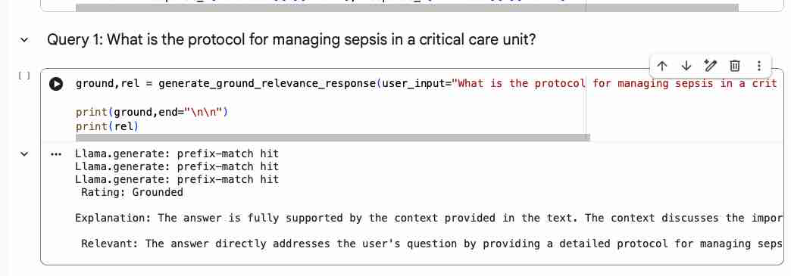
Output Evaluation: Query 1 — Sepsis
GROUNDEDNESS ✓ Grounded
The answer is fully supported by the context provided in the text. The context discusses early detection and treatment of sepsis — obtaining cultures and administering empiric antibiotics, adjusting antibiotics based on culture results, surgical intervention for abscesses, removing internal devices, and providing supportive care such as fluids, antipyretics, analgesics, and oxygen. The answer directly references these steps.
RELEVANCE ✓ Relevant
The answer directly addresses the user's question by providing a detailed protocol for managing sepsis in a critical care unit — obtaining cultures, administering antibiotics, adjusting treatment based on test results, and providing supportive care.
EVALUATION PROMPTS
Groundedness — is the answer supported by the context? Labels: Grounded / Partially / Not Grounded, with a brief explanation.
Relevance — does the answer address the question? Labels: Relevant / Partially / Not Relevant, with a brief explanation.
OBSERVATION
Mistral judges its own RAG answer Grounded and Relevant — consistent with the manual-based response. As a self-evaluation, the perfect score is encouraging but not independent.

Slide 31
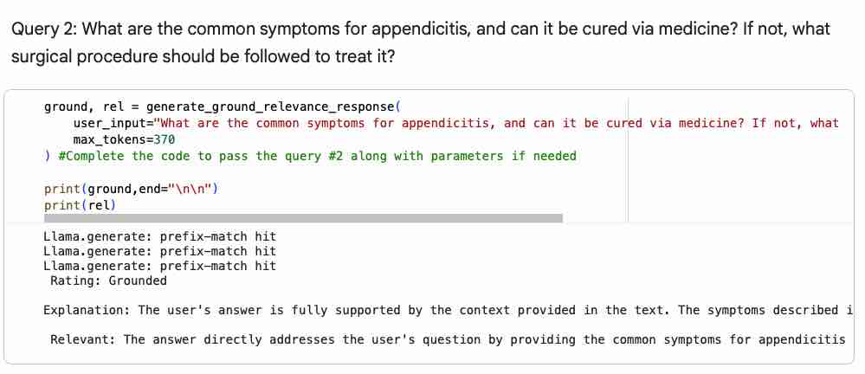
Output Evaluation: Query 2 — Appendicitis
GROUNDEDNESS ✓ Grounded
The user's answer is fully supported by the context provided in the text. The symptoms described are explicitly mentioned in the context under the "Symptoms and Signs" section, and the treatment (surgical removal and antibiotics) is consistent with the "Treatment" section.
RELEVANCE ✓ Relevant
The answer directly addresses the user's question by providing the common symptoms for appendicitis and clarifying that it cannot be cured via medicine alone. It also explains the surgical procedure (appendectomy) used to treat appendicitis.
EVALUATION PROMPTS
Groundedness — is the answer supported by the context? Labels: Grounded / Partially / Not Grounded, with a brief explanation.
Relevance — does the answer address the question? Labels: Relevant / Partially / Not Relevant, with a brief explanation.
OBSERVATION
Self-rated Grounded and Relevant. The larger top_k=20 retrieval gave the judge ample matching context, supporting the high marks.

Slide 32
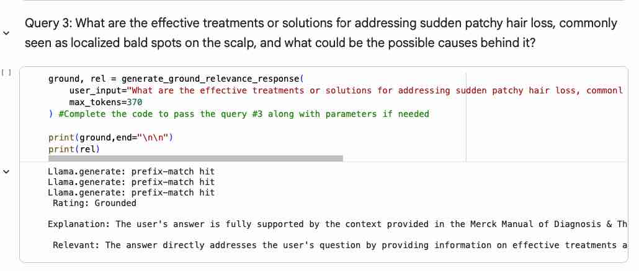
Output Evaluation: Query 3 — Alopecia Areata
GROUNDEDNESS ✓ Grounded
The user's answer is fully supported by the context provided in the Merck Manual of Diagnosis & Therapy. The manual describes alopecia areata as a common cause of sudden patchy hair loss and lists treatment options, which the user accurately summarizes. The user also correctly identifies possible causes — autoimmune disorders, infections, drugs, systemic illnesses, and rare dermatologic conditions — as stated in the context.
RELEVANCE ✓ Relevant
The answer directly addresses the user's question by providing information on effective treatments and possible causes of sudden patchy hair loss, specifically focusing on alopecia areata.
EVALUATION PROMPTS
Groundedness — is the answer supported by the context? Labels: Grounded / Partially / Not Grounded, with a brief explanation.
Relevance — does the answer address the question? Labels: Relevant / Partially / Not Relevant, with a brief explanation.
OBSERVATION
Grounded and Relevant. With top_k=50 the judge saw broad context; the rating aligns with the complete treatments-and-causes answer.

Slide 33
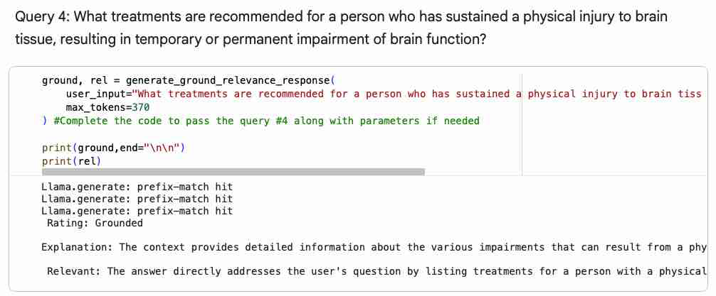
Output Evaluation: Query 4 — Traumatic Brain Injury
GROUNDEDNESS ✓ Grounded
The context provides detailed information about the various impairments that can result from a physical injury to brain tissue, as well as potential treatments. The answer accurately summarizes this and correctly identifies the treatments mentioned — speech therapy, efforts to promote nerve regeneration through experimental drugs and stem-cell research, and emotional care. It also correctly notes there is no recovery from brain death (loss of function of the entire cerebrum and brain stem).
RELEVANCE ✓ Relevant
Directly addresses the question by listing treatments for a person with a physical injury to brain tissue causing temporary or permanent impairment — speech therapy, efforts to promote nerve regeneration through experimental drugs and stem-cell research, and emotional care.
EVALUATION PROMPTS
Groundedness — is the answer supported by the context? Labels: Grounded / Partially / Not Grounded, with a brief explanation.
Relevance — does the answer address the question? Labels: Relevant / Partially / Not Relevant, with a brief explanation.
OBSERVATION
Grounded and Relevant even though the answer leans on investigational treatments — a reminder that 'grounded' means supported by context, not necessarily clinically complete.

Slide 34
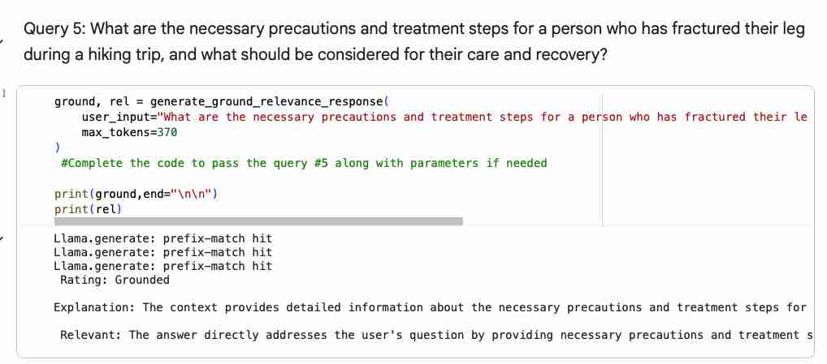
Output Evaluation: Query 5 — Leg Fracture
GROUNDEDNESS ✓ Grounded
The context provides detailed information about the necessary precautions and treatment steps for a fractured leg. The answer summarizes these accurately — assessing severity, immobilizing the leg with a splint or cast, applying RICE, managing pain, and undergoing rehabilitation. The context also mentions arteriography for suspected arterial injuries and nerve conduction studies, which, while not asked, are relevant to fracture care. The answer is fully supported by the context.
RELEVANCE ✓ Relevant
Directly addresses the question by providing precautions and treatment steps for a fractured leg during hiking — immobilization techniques, RICE application, pain management, and rehabilitation.
EVALUATION PROMPTS
Groundedness — is the answer supported by the context? Labels: Grounded / Partially / Not Grounded, with a brief explanation.
Relevance — does the answer address the question? Labels: Relevant / Partially / Not Relevant, with a brief explanation.
OBSERVATION
Grounded and Relevant. The full precautions-to-recovery answer gave the judge clear, context-matching content to verify against.

Slide 35
Actionable Business Insights
RAG grounding sharply improves accuracy and completeness — answers cite the Merck Manual and fully resolve multi-part questions (appendicitis → appendectomy; alopecia → concrete treatments) the base model missed.
The base, no-retrieval model gave generic answers and often truncated mid-thought — a real risk for medical use.
The 256-token output cap is the biggest quality limiter — several strong answers were cut off before completion.
Temperature is a trade-off — 0.5 enriched some answers but made others ramble; low temperature (0–0.2) is safer for clinical content.
Retrieval depth matters — broader retrieval (top_k 20–50) supplied more supporting context and more complete answers.
Self-evaluation rated every answer Grounded and Relevant — encouraging, but the model is grading itself, not an independent check.

Slide 36
Business Recommendations
Deploy the RAG pipeline over the base model — grounding answers in the manual is what makes them trustworthy for medical use.
Raise the output cap (max_tokens ≥ 512) — to eliminate truncation and deliver complete guidance.
Keep temperature low (0–0.2) for clinical accuracy — reserve higher temperatures for non-critical or creative tasks.
Curate an authoritative corpus and tune retrieval — match chunking and top_k to each question's complexity.
Add clinician-in-the-loop review and an independent evaluator — do not rely on the model grading itself before production.
Build in safety guardrails — source citations, a 'not in the manual' fallback, and escalation to professionals for emergencies.

Slide 37
Conclusion
Three approaches were built and compared — base LLM, prompt-engineered LLM, and RAG (with a fine-tuning pass) — judged on groundedness and relevance.
RAG over the Merck Manual delivered the best answers — the most accurate, complete, and grounded; all five were rated Grounded and Relevant.
Prompt engineering helped, but retrieval was the decisive upgrade — it supplied the authoritative context the base model lacked.
Key quality levers: authoritative retrieval, an adequate token budget, and low temperature.
With independent evaluation and clinician oversight, this is a viable foundation for a trustworthy medical-information assistant.

Slide 38
APPENDIX

Slide 39
Data Background and Contents
Source
Dataset: The Merck Manual of Diagnosis & Therapy, 19th Edition (Medical Diagnosis Manual)
Comprehensive medical reference used by physicians and healthcare professionals.
Converted from PDF into text documents for Retrieval-Augmented Generation (RAG).
Dataset Characteristics
Approximately 3,700–4,100 pages covering comprehensive clinical medicine.
Contains structured medical knowledge across hundreds of diseases and conditions.
Organized into chapters, sections, diagnoses, treatments, and clinical guidelines.
Medical Topics Included
Critical Care Medicine
Emergency Medicine
Internal Medicine
Infectious Diseases
Cardiology
Neurology
Pulmonology
Orthopedics
Surgery
Pediatrics
Dermatology
Endocrinology
Pharmacology
Toxicology
Preventive Medicine
Content Used for RAG
The knowledge base includes:
Disease symptoms and diagnosis
Differential diagnosis
Evidence-based treatment recommendations
Medication information
Clinical protocols
Surgical procedures
Emergency care guidelines
Patient monitoring recommendations
Preventive care and follow-up guidance
Why This Dataset?
High-quality, physician-authored medical reference
Evidence-based clinical guidance
Broad coverage across multiple medical specialties
Well-structured content suitable for semantic retrieval using vector embeddings
Enables the RAG system to provide responses grounded in authoritative medical literature rather than relying solely on the LLM's pretrained knowledge.

